Slide 1



B.V.V Sangha’s
Department of Computer Science & Engineering
Mini Project Review 3
On
Exam Reminder System
Under the Guidance of
Dr.Mahantesh Mathapati
Professor
Dept. of CSE,AIEMS
Presented By :
Likhitha.K.C (1AR23CS041)
Gagana.K (1AR23CS023)
Keerthana.N (1AR23CSO35)

Slide 2
Introduction
Exam Reminder System helps students receive timely exam notifications.
Built as a simple web-based application for easy access.
Allows entering exam details like date, time, subject, and room.
Sends reminders directly to students through email.
Reduces manual effort for teachers and avoids miscommunication.
Ensures students stay prepared and do not miss exams.

Slide 3
Abstract
Project provides an automated solution for sending exam reminders.
Uses EmailJS to deliver emails without needing a backend.
Collects exam details and generates personalized reminders.
Saves time by removing manual reminder processes.
Works fully in the browser, making it lightweight and efficient.
Ensures timely communication between students and institutions.

Slide 4
Literature Review
SL.NO | AUTHOR | YEAR | ABSTRACT
01 | B. J. Fogg | 2009 | This study explains the Fogg Behavior Model, showing how digital triggers such as reminders and notifications help users complete tasks on time. It supports the idea that technology-based reminders improve student responsibility, focus, and timely exam preparation.
02 | Richard H. Thaler & Cass R. Sunstein | 2008 | Their Nudge Theory highlights how small, well-timed prompts influence user behavior. Automated exam reminders act as digital nudges, reducing forgetfulness and improving exam attendance in academic settings.
03 | John Hattie | 2012 | Hattie’s educational research emphasizes that timely feedback and structured guidance enhance student performance. Reminder systems align with this by giving timely cues that support academic planning and preparation.
04 | Carolyn J. Heinrich | 2015 | Her work on educational technology

Slide 5
Problem Statement
Students often forget exam dates due to busy schedules, lack of proper reminders, or poor organization. Teachers also face difficulty in manually informing every student about upcoming exams, which can lead to miscommunication and missed exams. There is a need for an automated system that can store student details, read exam schedules, and send timely reminders without manual effort.

Slide 6
Objectives of the Project
1. To automate the process of sending exam reminders to students.
2. To ensure students receive accurate and timely exam notifications.
3. To reduce chances of students forgetting or missing exams.
4. To simplify reminder management using a web-based system.
5. To improve communication and organization in the academic process.
6. To provide a fast, user-friendly, and backend-free reminder solution.

Slide 7
Design and Analysis :
Frontend web app built with HTML, CSS, JavaScript
Login & Signup with password toggle
Dashboard for sending exam reminders
EmailJS integration for email delivery
Local Storage for saving user data & history

Slide 8
User-friendly and works without a backend
Fast email sending through EmailJS
Suitable for small-scale or demo use
Limited security (localStorage + exposed keys)
Needs backend for secure, real-world deployment

Slide 9
Implementation:
1. Frontend Development:The system is built using HTML, CSS, and JavaScript.
2. User Authentication:Login, Signup, and Forgot Password are implemented using localStorage to store user accounts.
3. Password Toggle:Eye icon is used to show/hide passwords using JavaScript.
4. Theme System:Light/Dark mode toggle is implemented and saved in localStorage.
5. Dashboard Navigation:Sidebar menu switches between Exam Reminder and History pages.
6. Exam Reminder Form:User enters student name, email, exam date, time, subject, seat, and room.

Slide 10
7. Email Sending (EmailJS):Form data is sent through EmailJS using service ID and template ID to deliver reminder emails.
8. History Management:Every sent email is saved in localStorage with timestamp.
9. History Features:Supports viewing, resending, exporting as JSON, and clearing history.10. Fully Browser-Based:No backend required; everything works using browser storage and EmailJS.

Slide 11
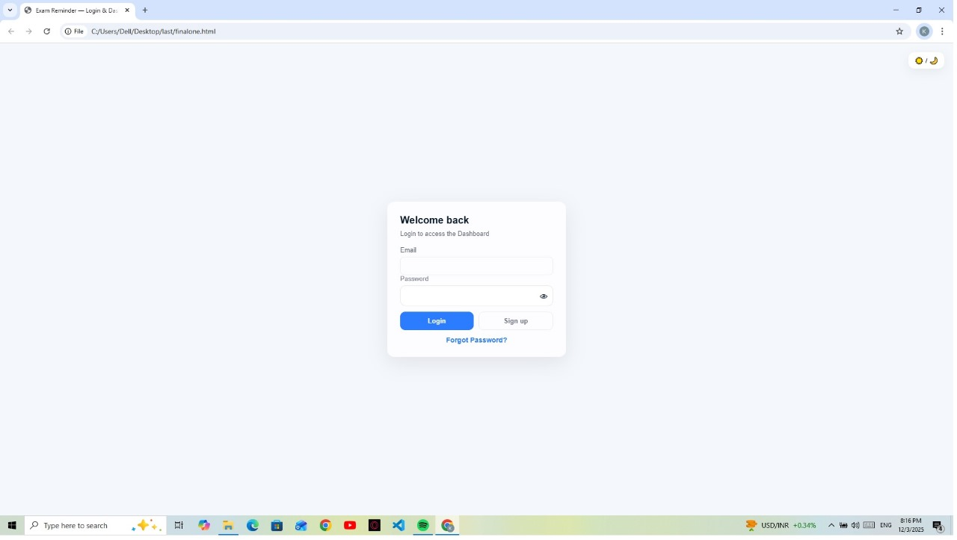
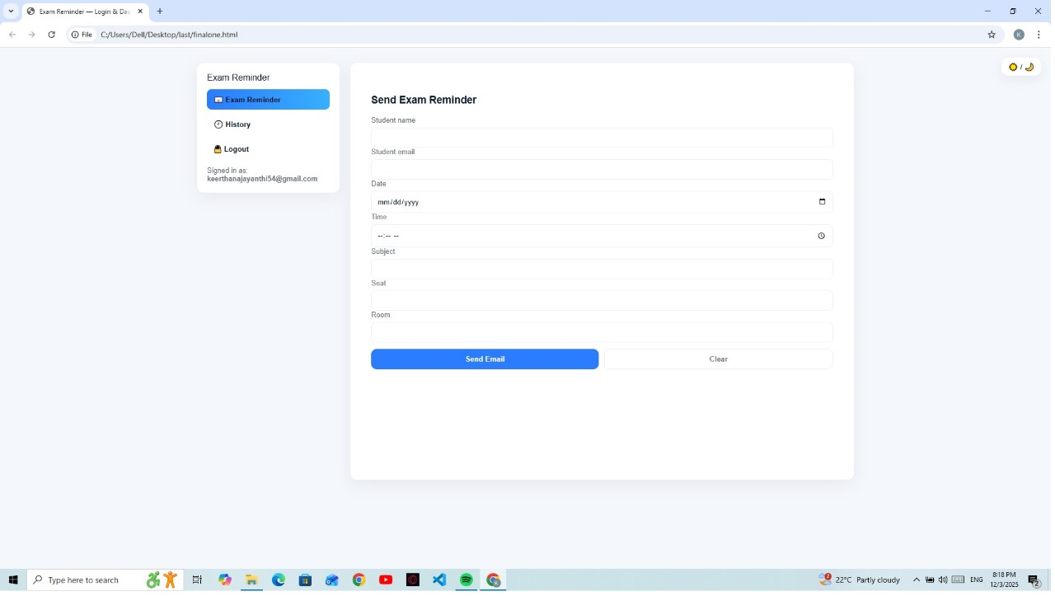
Result

Slide 12
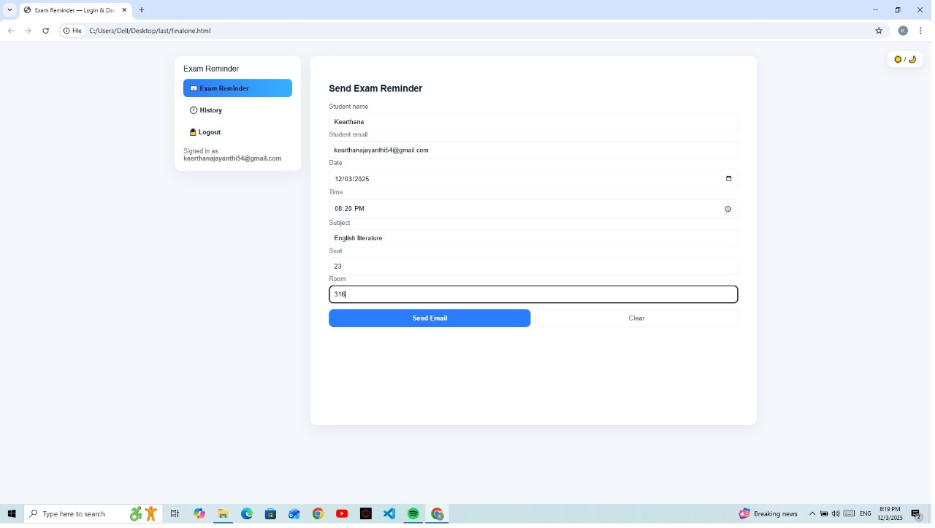
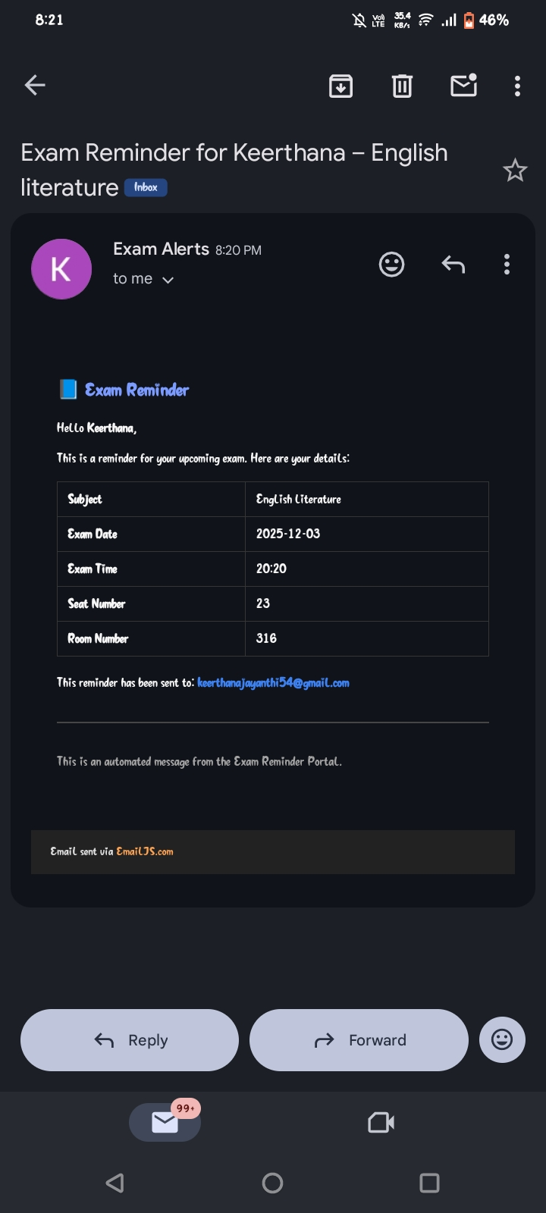

Slide 13
Reference
2022
Nordby, E. S., Gjestad, R., Kenter, R. M. F., Hansen, J. H., Nordgreen, T. – SMS reminders in a self-guided internet intervention for adults with ADHD
Péter, Zs., et al. – Large-scale field experiment on automated encouragement messages via SMS/email before exams
2023
Brandt, A., Hermann, J., Rohde, K. – Randomized controlled trial on SMS “nudges” improving exam performance
2024
Brandt, A., Hermann, J., Rohde, K. – Expanded study on periodic SMS nudges and higher-education student performance

Slide 14
Conclusion:
The Exam Reminder System successfully automates the process of notifying students about upcoming exams. It reduces manual effort, improves communication, and ensures that students receive timely reminders. This system enhances academic organization, minimizes missed exams, and provides a simple, efficient, and reliable solution for managing exam schedules. Overall, the project demonstrates how automation can effectively support both students and educational institutions.

Slide 15


